Slide 1
Fertilizing Growth
Enabling A Healthy World

Slide 2
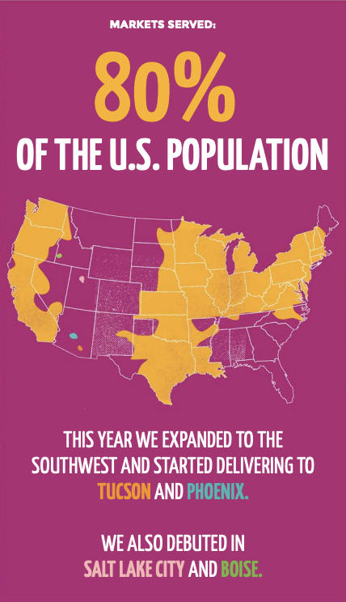

2020: An Imperfect Record Year
~$500,000,000 in revenue rate
~400,000 Total Customers
~13,000 Reduced Cost Box Customers
~38 states
How Do We Grow Imperfect Foods?
**https://static1.squarespace.com/static/576072d47da24f674fa39bdb/t/604a82db69a44e2ca2f9823d/1615495957171/210309-IF-ImpactReport-Final.pdf

Slide 3
Data Science Solutions
Classification : Group and rank counties for expansion
High Population, High Income
SNAP Eligible
Low Income, Low Access
Food Deserts
Population Density
Regression: Use internal data with demographics for features importance
Age
Family Size
Geographic
Income
Retention

Slide 4


How We Grow in 2021
Hypothesis:
Using government data, strategically target new markets to enter, choosing states and counties to maximize revenue and social impact
Datasets
US Census Data (2014-2019)
USDA Food Atlas (2017)
US Bureau of Economic Analysis (2020)
Google Trends
Risks
Snapshot/Out of Date Data
Food Deserts Good Markets?
State Regulations/Market Barriers
Competition
Measure: Growth in both customer segments

Slide 5
What is a food desert?

Slide 6

In 2010, the United States Department of Agriculture reported that 23.5 million people in the U.S. lived in "food deserts"
More than one mile from a supermarket in urban or suburban areas and more than 10 miles from a supermarket in rural areas.
https://www.ers.usda.gov/webdocs/publications/45014/30940_err140.pdf

Slide 7
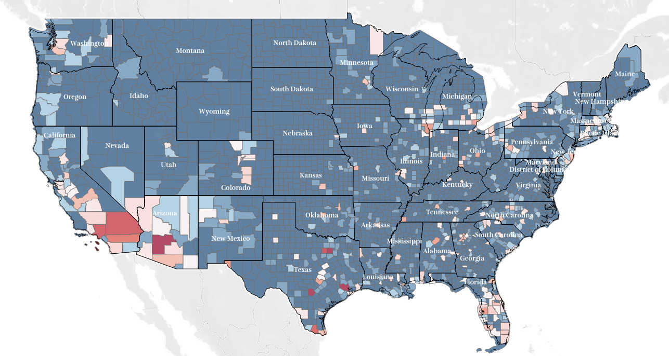
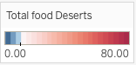
Food Deserts Across the United States
8,959
Food Deserts
85%
Urban Areas
37,000,000
People

Slide 8
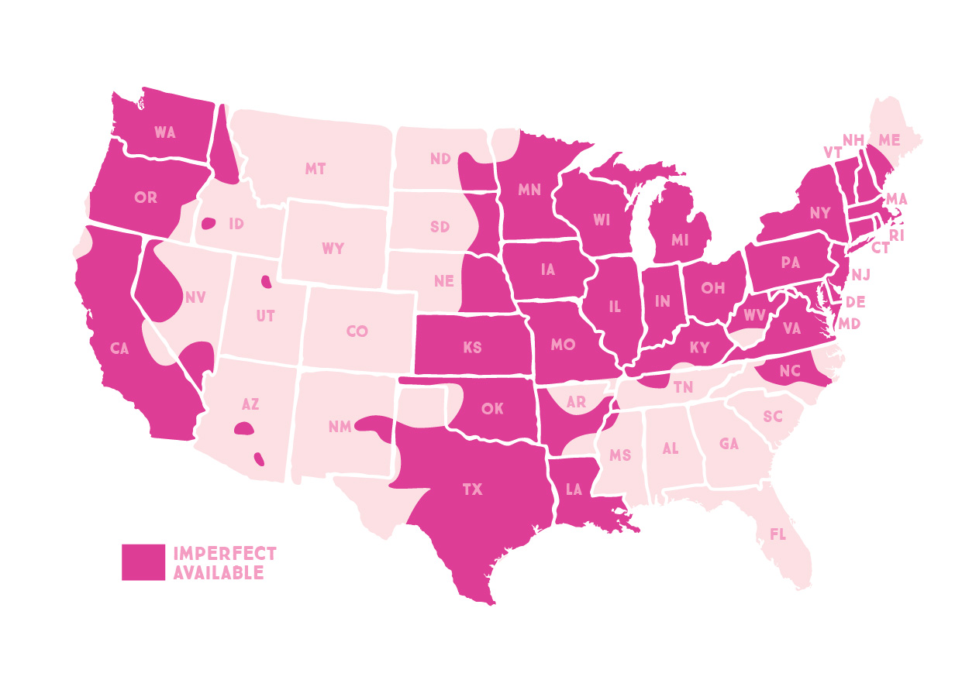
74 Million Population including Hawaii/Alaska
**https://static1.squarespace.com/static/576072d47da24f674fa39bdb/t/604a82db69a44e2ca2f9823d/1615495957171/210309-IF-ImpactReport-Final.pdf

Slide 9
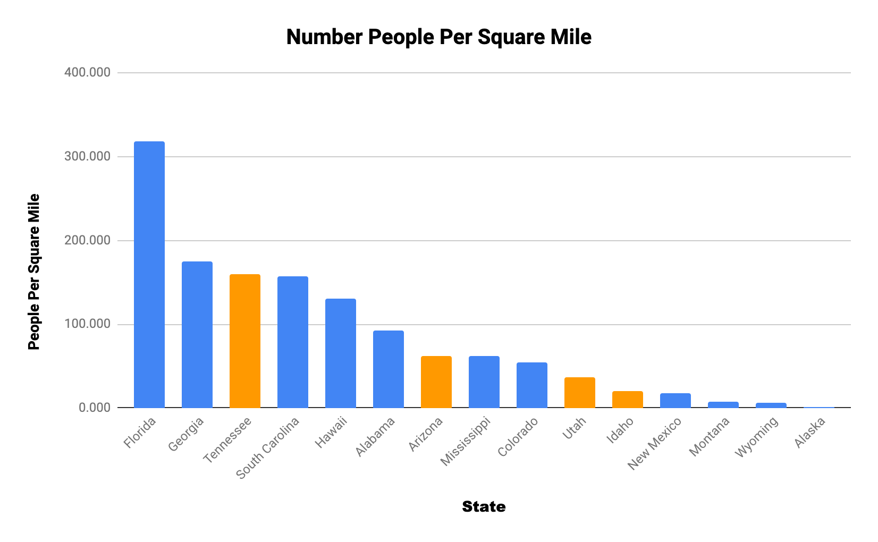
Where to Next?
Population Density to Capture large population with low carbon footprint
Orange States: Imperfect Foods launched end Q4 2020
Eliminate
-Low Density States
-High Transportation
-States with the 30-50% penetration

Slide 10
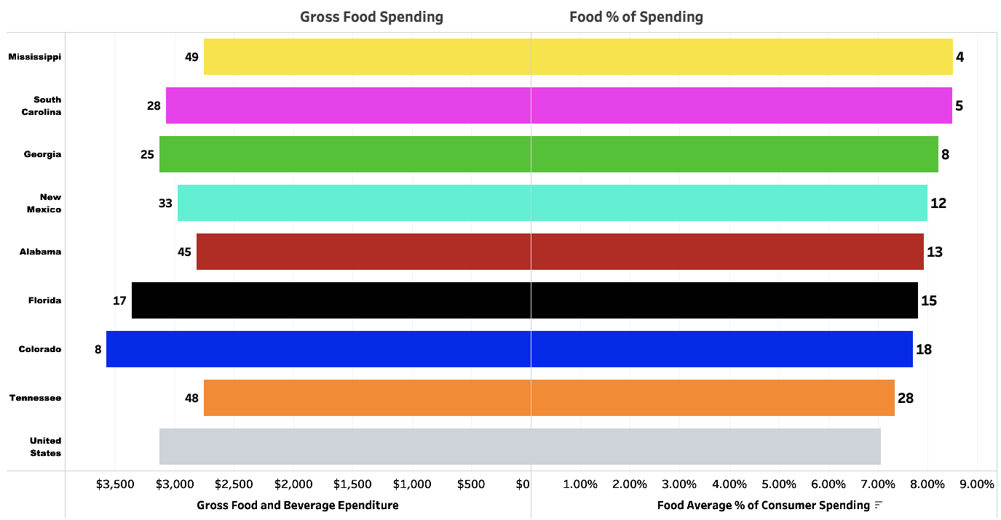
Fairly Cheap, Relatively Expensive
40% of the top 15 relative food expenses states

Slide 11
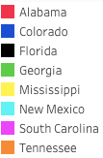
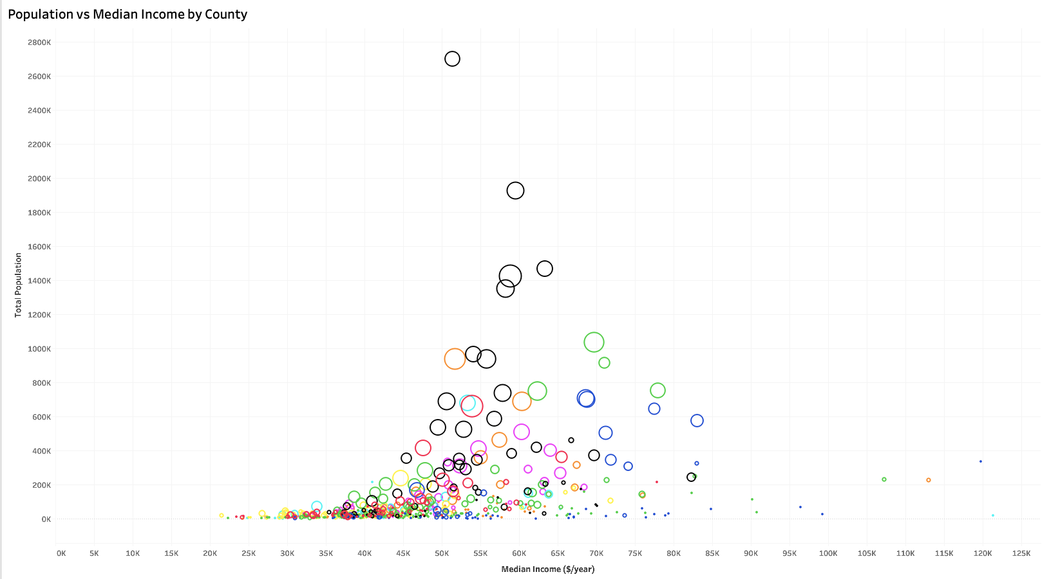
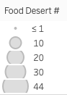
County Selection

Slide 12
Conclusions
Top Market: Florida
States: Florida, South Carolina, Georgia and rest of Tennessee
Facility Investment: Jacksonville, Orlando or Atlanta
Other Cities: Denver, Albuquerque

Slide 13
Future Analysis
Update with 2020 Census Data
Competitor Analysis
Investigate SNAP eligibility
Explore Insta-Meals / Recipe Boxes

Slide 14

Questions

Slide 15
Appendix

Slide 16
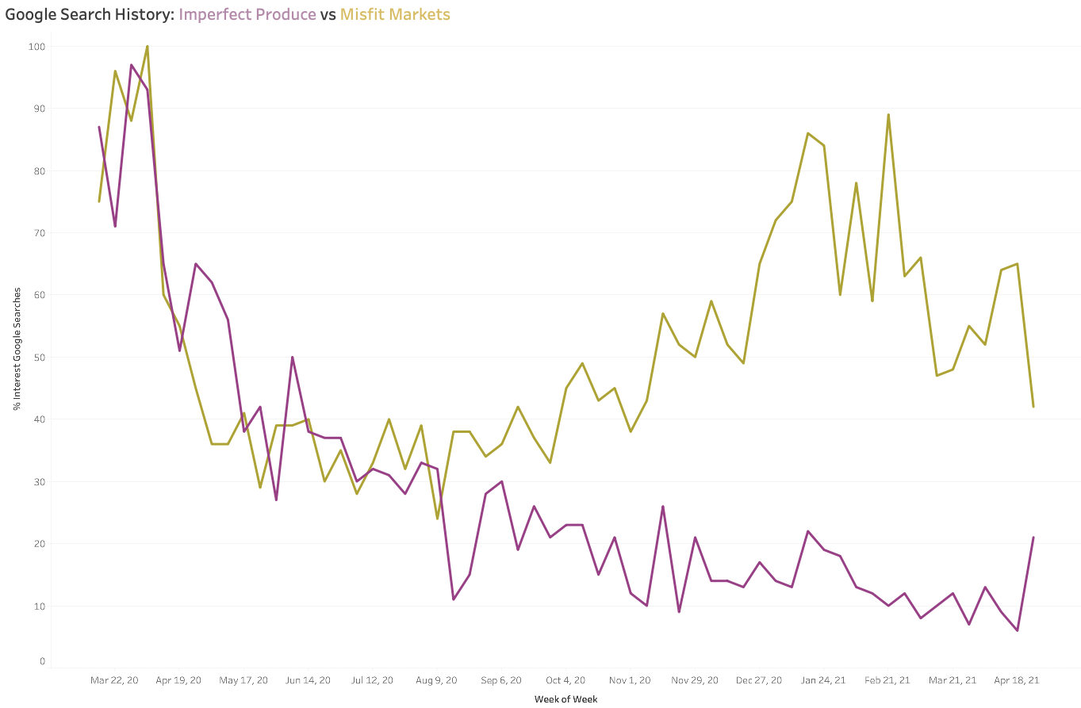
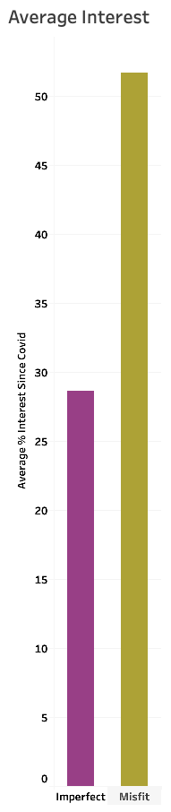
Tracking the Competition

Slide 17
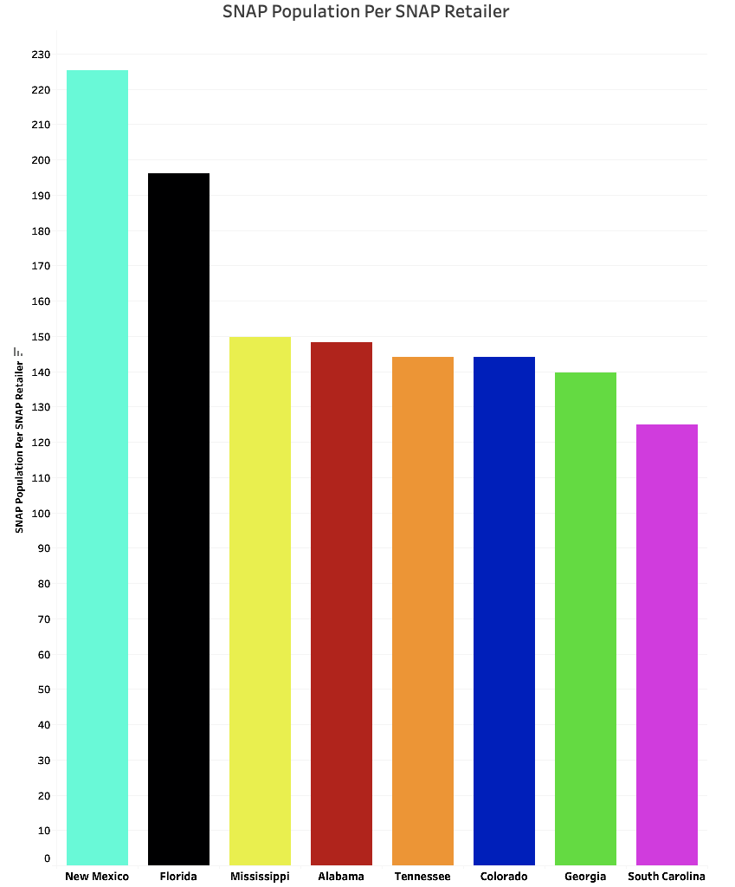
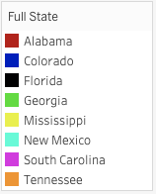
SNAP Availability
Ratio is measuring number of people per retailer that accepts SNAP benefits
Higher the ratio, less options for SNAP population
US Average around 150 People person location that accepts SNAP Benefits
US Average

Slide 18
County Selection
Miami
Miami
Tampa
Miami
Orlando
Tampa
Jacksonville
Memphis
Atlanta
Denver

Slide 19
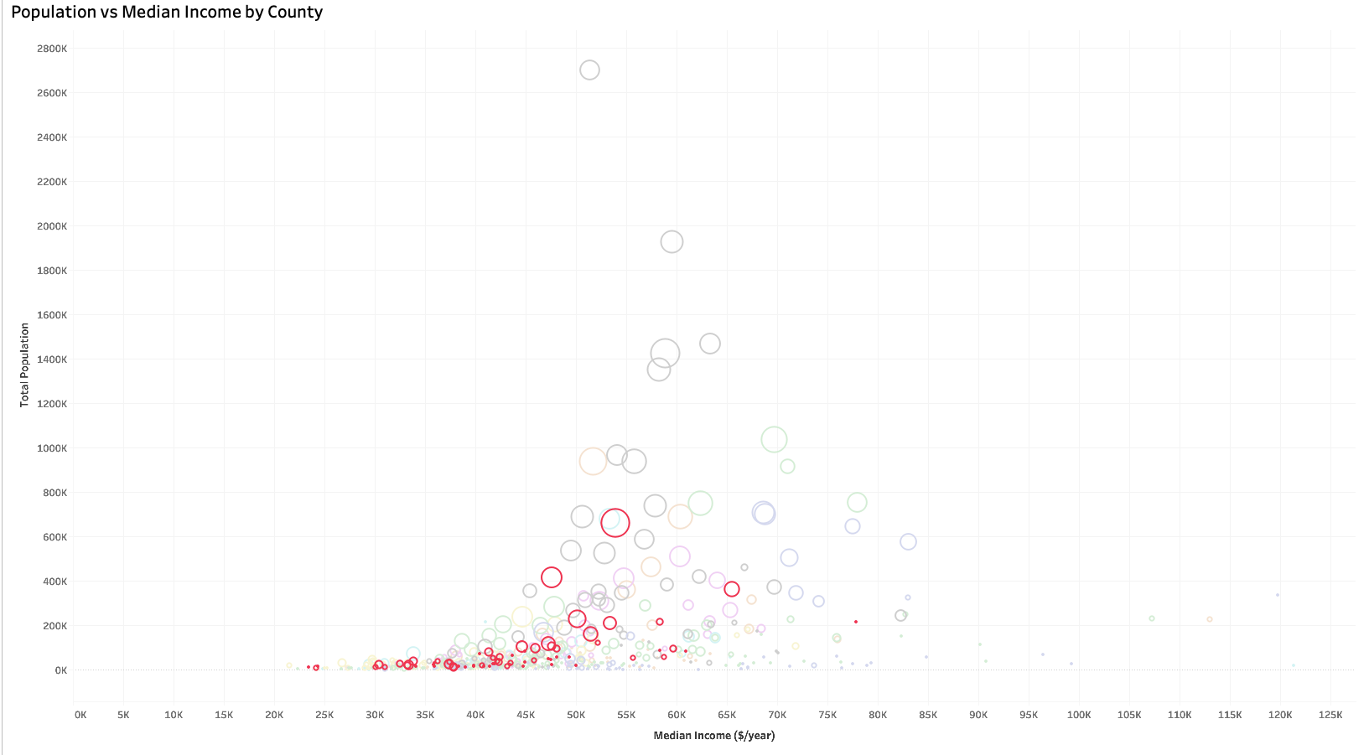
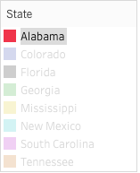
Alabama

Slide 20
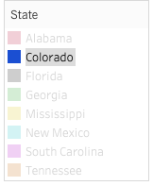
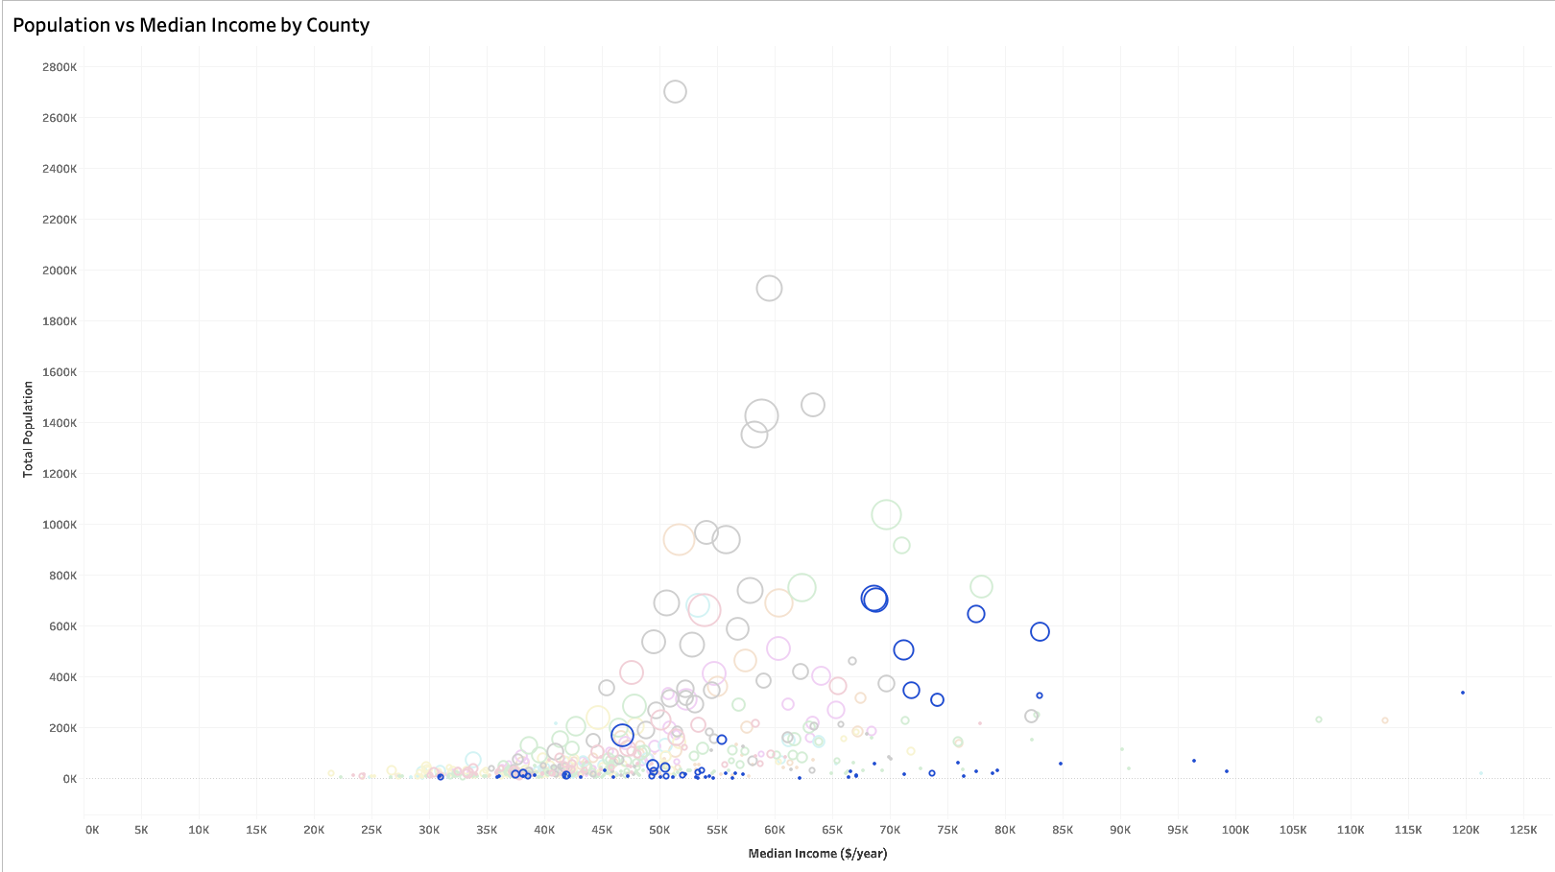
Colorado

Slide 21
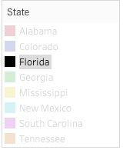
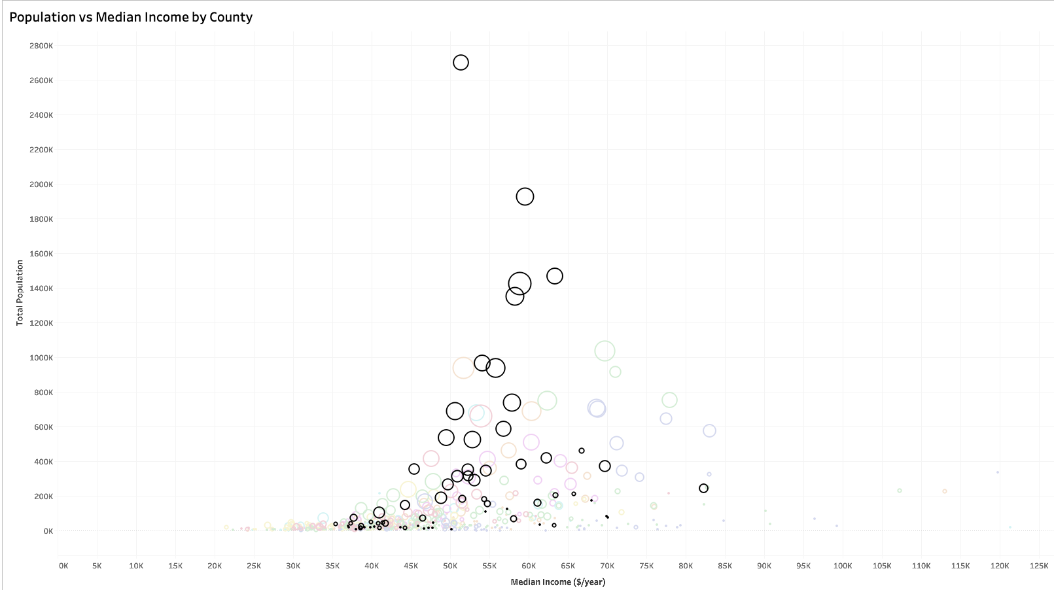
Florida

Slide 22
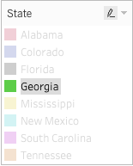
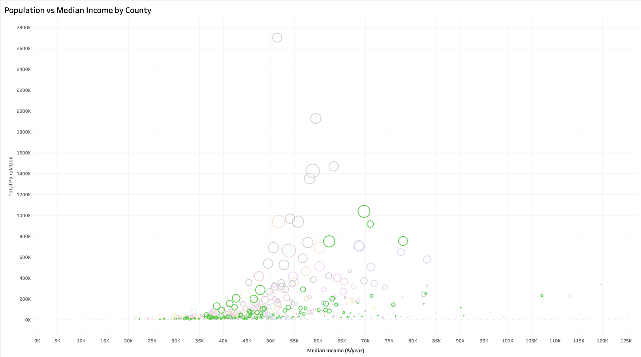
Georgia

Slide 23
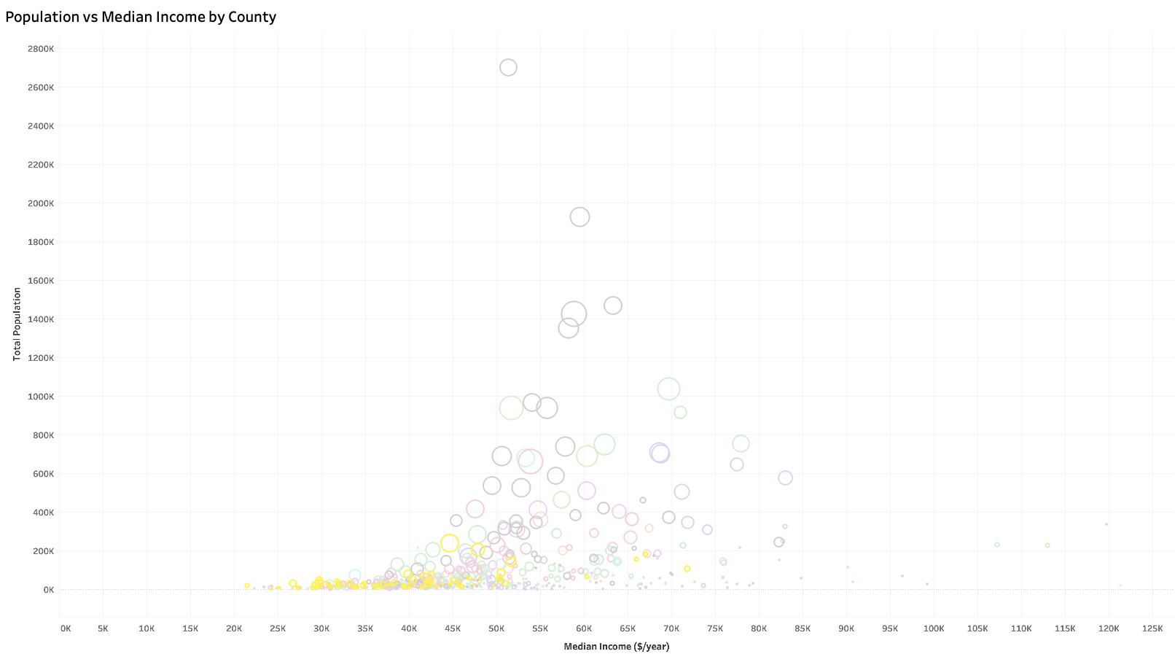
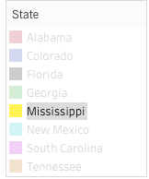
Mississippi

Slide 24
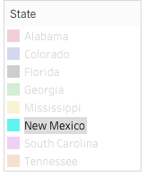
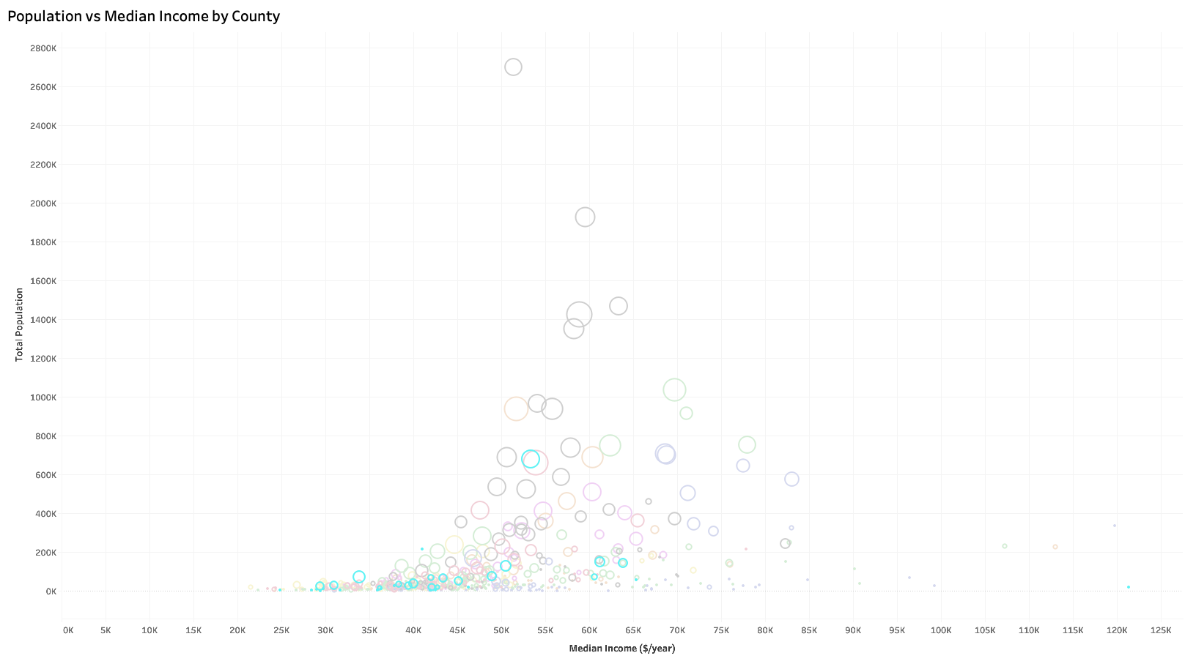
New Mexico

Slide 25
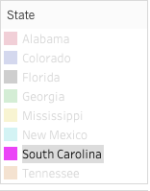
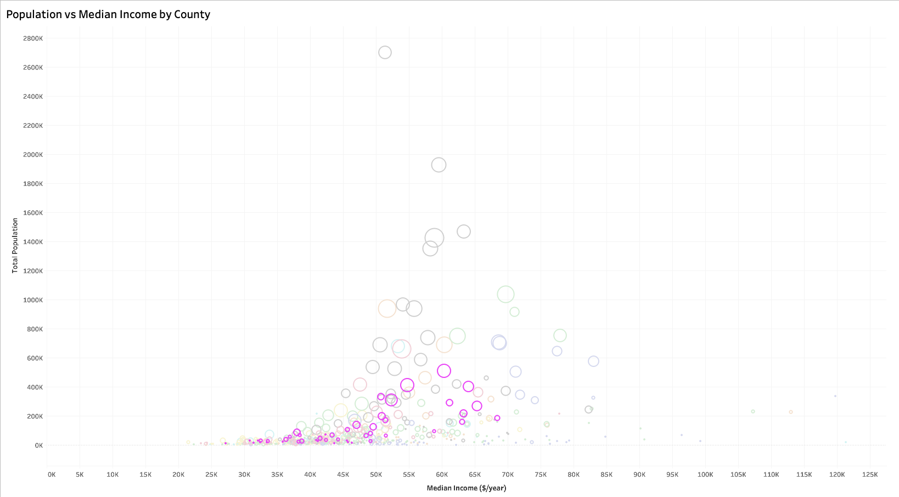
South Carolina

Slide 26
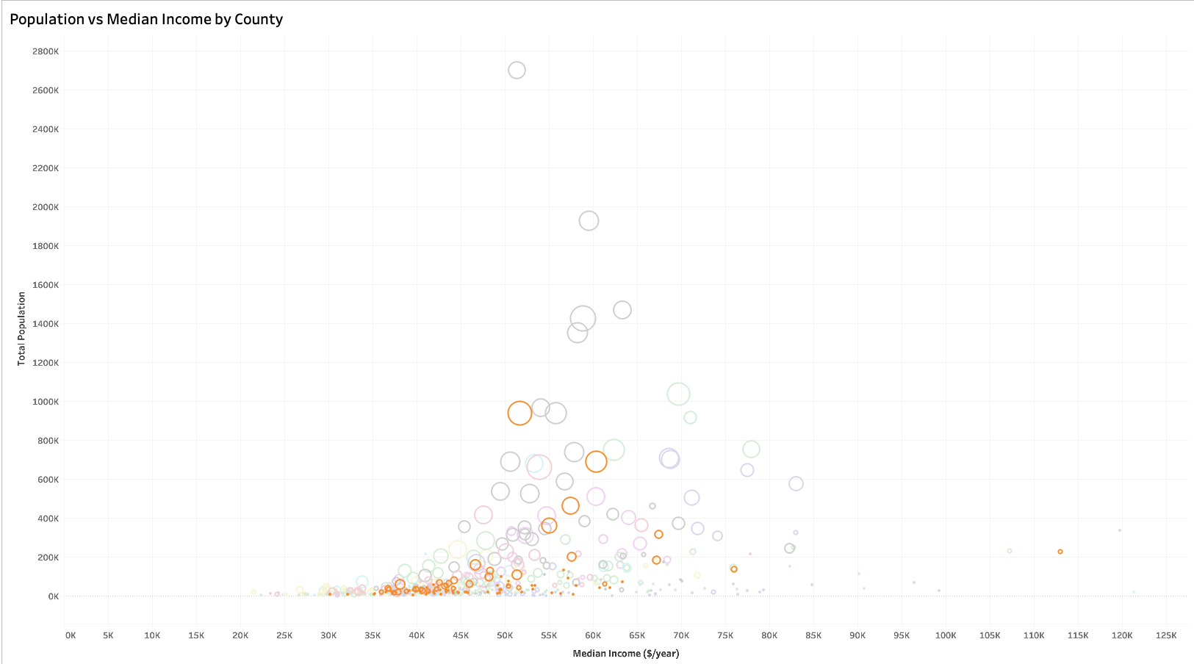
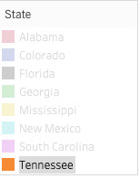
Tennessee

Slide 27
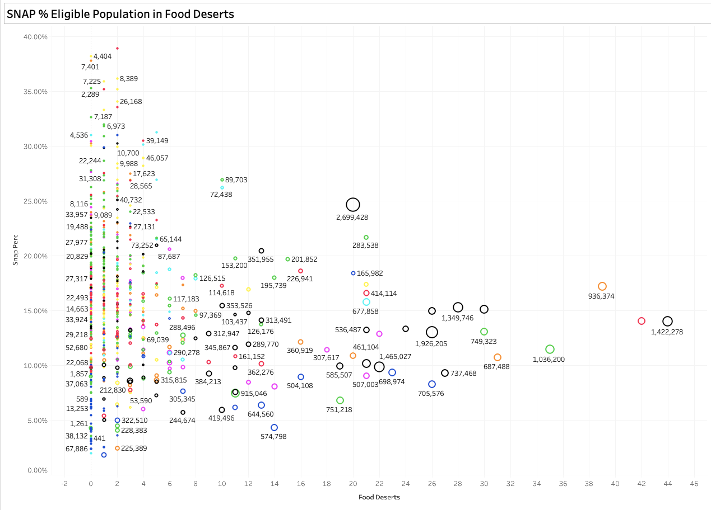
SNAP % vs Food Deserts (Population Labels)

Slide 28
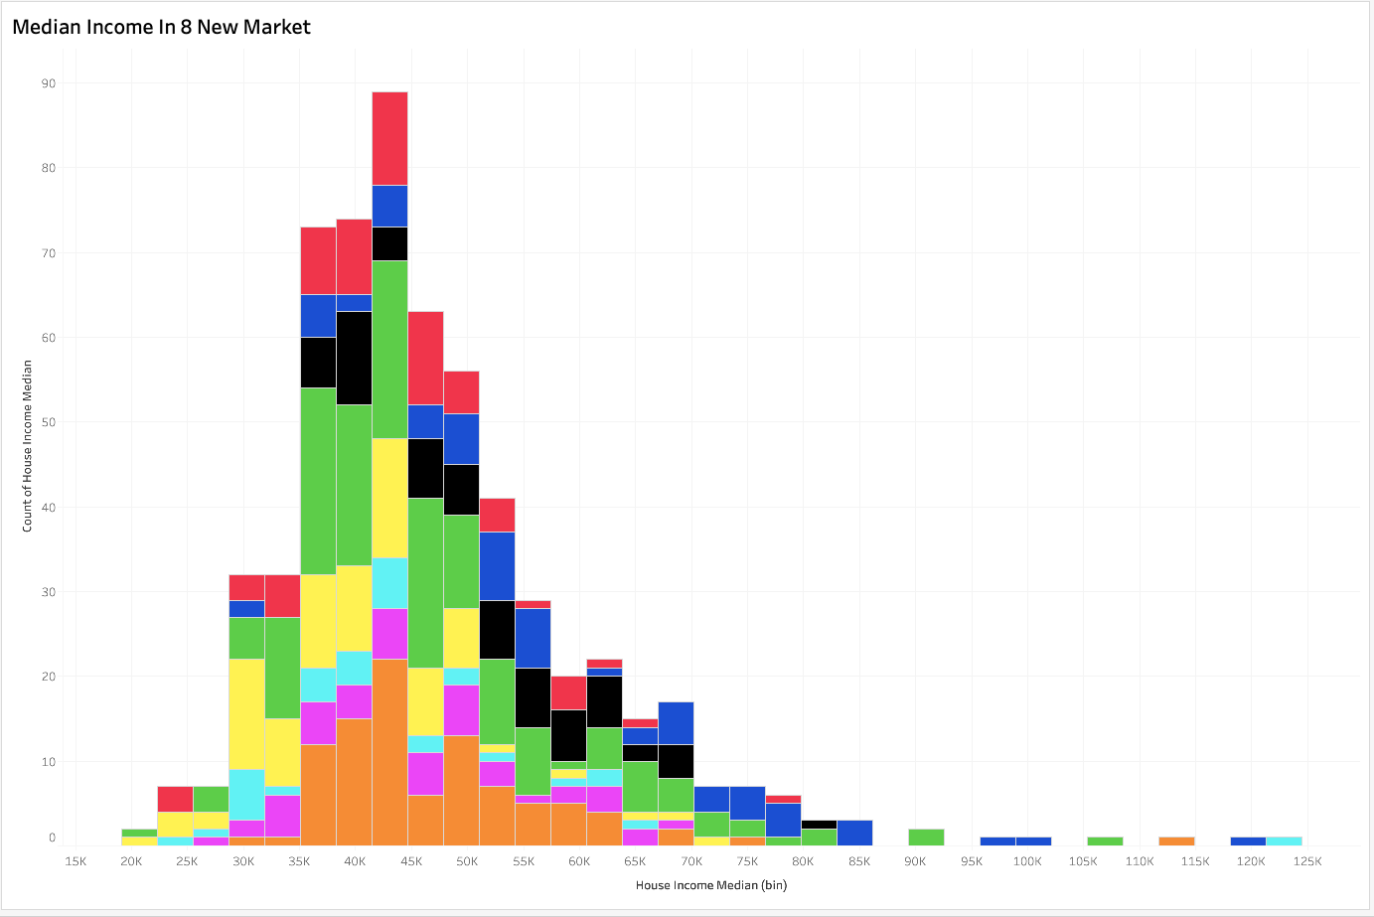
Median Income in 8 New Market States

